Slide 1
T99X171.00 Mechanical Damage FA Risk Assessment Report
VN-JBD-ME
Date: 2024.09.20

Slide 2
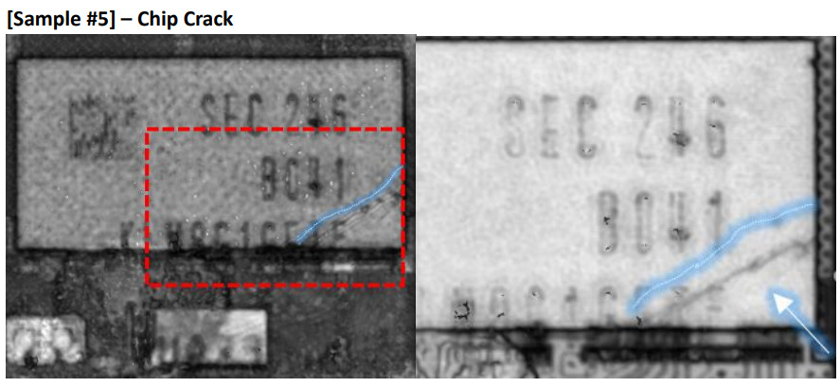
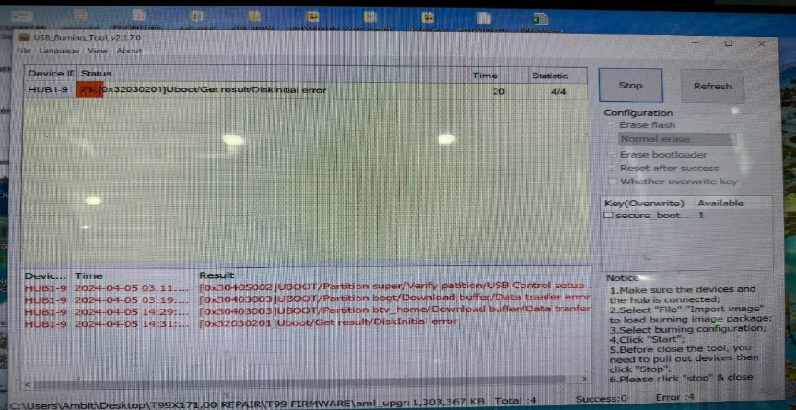
#1
Description issue
ALT customer feedback that they found out Top2 abnormal issue is: Product boot up fail and can't download Factory FW stop 7%
Fii analysis This issue follow eMMC U602 (P/N: 067.00140.005, Vendor: SAMSUNG) material fail.
Samsung vendor analysis eMMC abnormal FA report write cause IC mechanical damage.
FXN factory has re-check all process from SMT to FATP all IC mechanical damage risk. Pls help check it.
Download FW Stop 7%
Chip crack
Summary: There is 1 defective product that has been verified as an initial defect due to mechanical damage caused by some external stress.

Slide 3
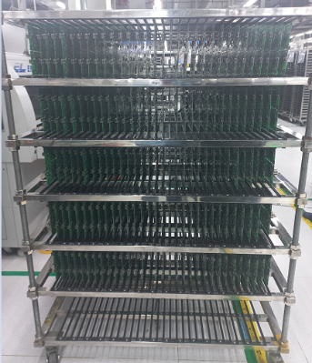
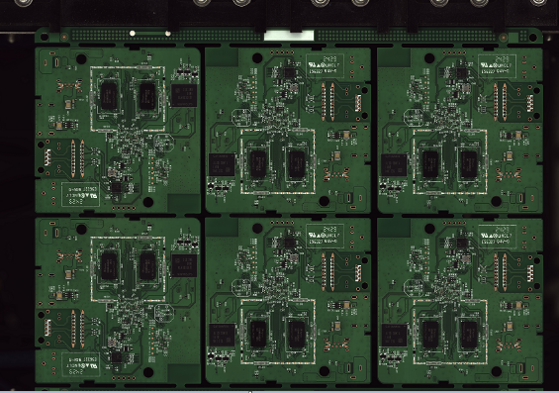
#2
T99X171.00 Mechanical Damage Risk Assessment Report
T99X171.00 Check process mechanical damage risk assessment
Fii factory has conducted a production process check to find out the risk of causing mechanical damage.
SMT
PTH
ASSY
TEST
PACK
Check SMT stage:
Panels are placed on trolleys at a safe distance, with no risk of collision.
Panel images recorded at the AOI station can check the components status.
Summary: At SMT stage, there are no risk of mechanical damage.

Slide 4
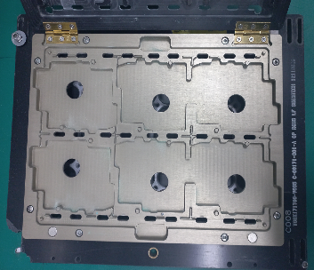
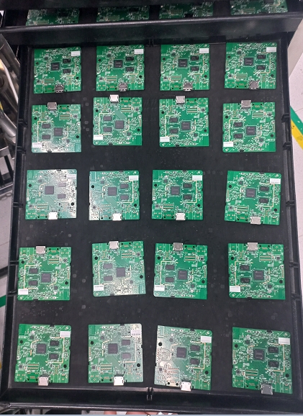
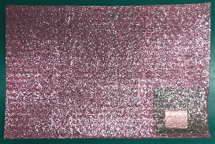
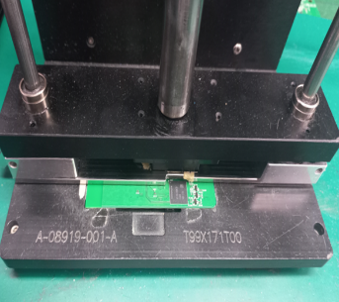
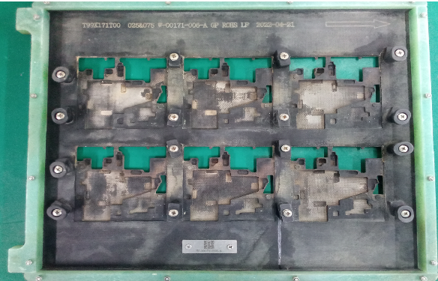
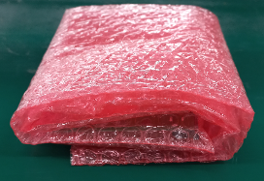
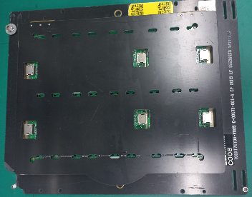
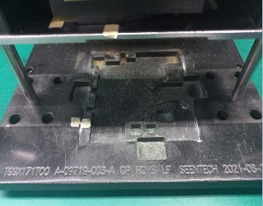
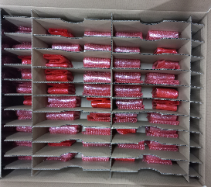
#3
T99X171.00 Mechanical Damage Risk Assessment Report
T99X171.00 Check process mechanical damage risk assessment
Check PTH stage:
eMMC
location
eMMC
location
eMMC
location
eMMC
location
PCBA cutting mold is designed to avoid collision with components.
The shield cover assembly mold is designed to avoid collision with components.
PCBA placed on tray, eMMC in contact with foam mat, no risk of collision.
PTH mold is designed to avoid collision with components.
PCBAs are placed in bubble bag and stacked in carton when transfer to other factory.
Summary: At PTH stage, there are no risk of mechanical damage.

Slide 5
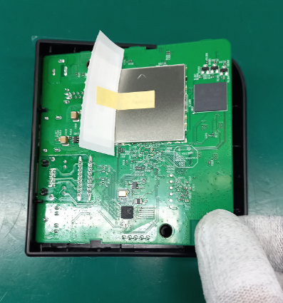
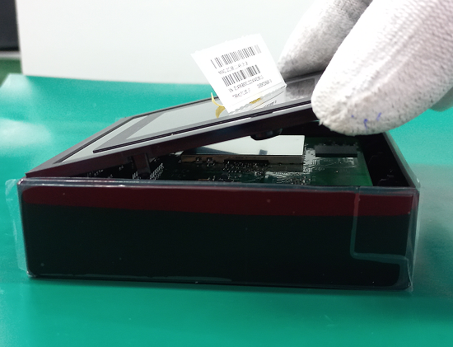
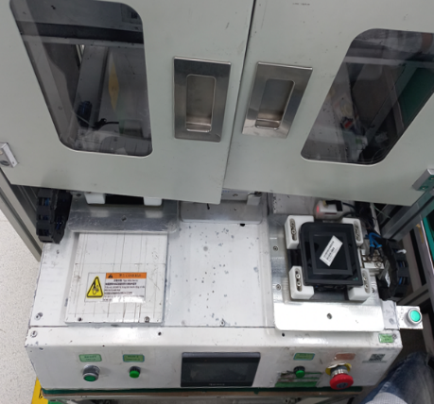
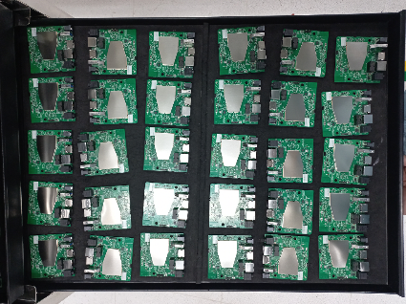
#4
T99X171.00 Mechanical Damage Risk Assessment Report
T99X171.00 Check process mechanical damage risk assessment
Check ASSY stage:
eMMC
eMMC
PCBA placed on tray, eMMC in contact with foam mat, no risk of collision.
Assemble PCBA into Top cover, OP does not touch eMMC when operating.
Assemble bot cover into top cover, OP places the edge of bot cover on the connector port side first.
Fasten screw by automatic screwdriver
Summary: At ASSY stage, there are no risk of mechanical damage.

Slide 6
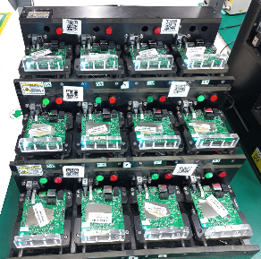
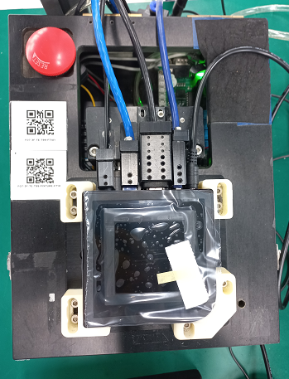
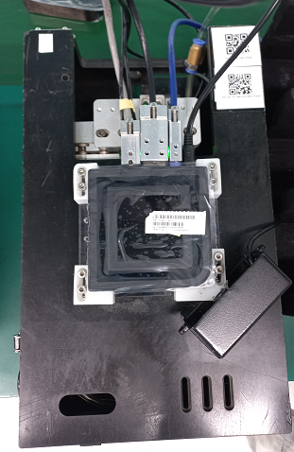
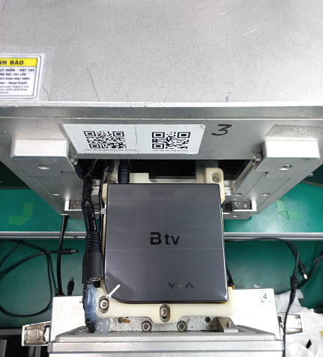
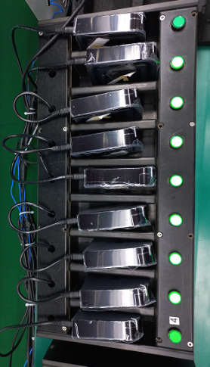
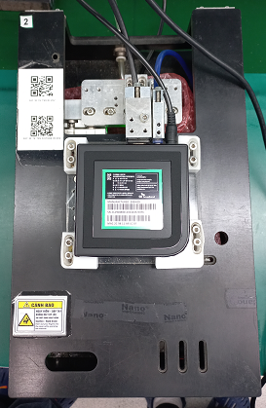
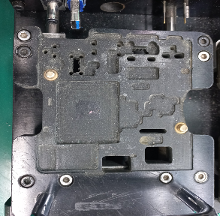
#5
T99X171.00 Mechanical Damage Risk Assessment Report
T99X171.00 Check process mechanical damage risk assessment
Check TEST stage:
eMMC
location
UK station mold is designed to avoid collision with components.
Summary: UK station mold is designed to avoid collision with components. => No have risk damage IC at all test station.

Slide 7
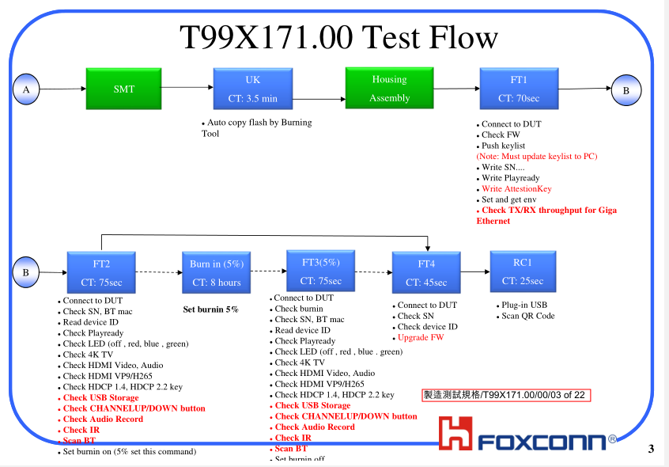
#6
T99X171.00 Mechanical Damage Risk Assessment Report
No Boot FATP Test Coverage:
Summary :
No boot then can’t test at all station ➔ No boot can cover 100% at FATP

Slide 8
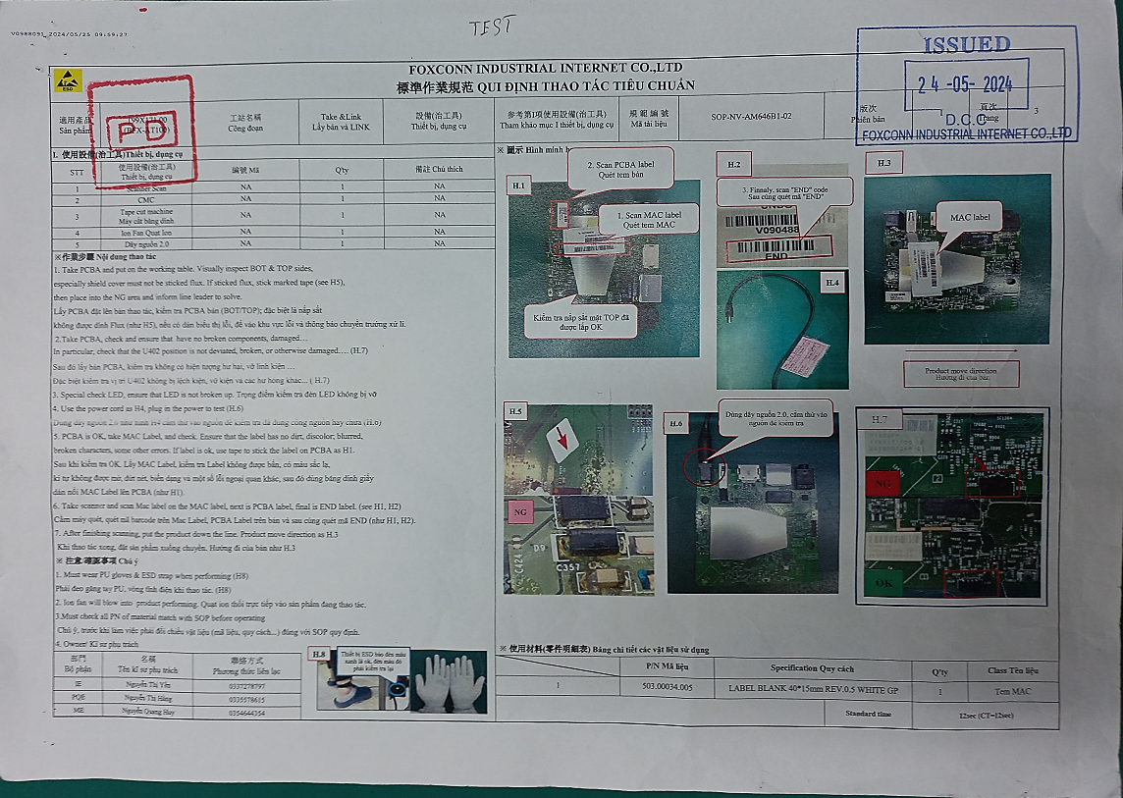
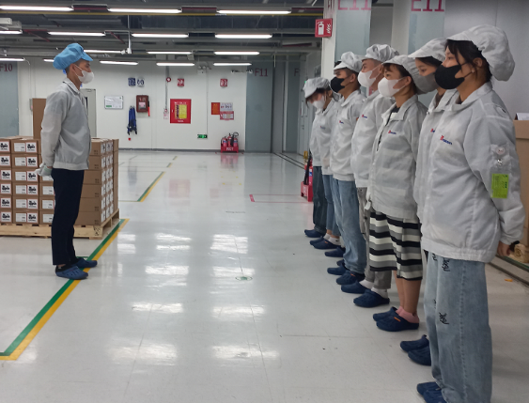
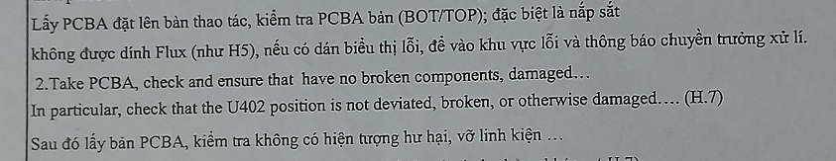
#6
T99X171.00 Mechanical Damage Risk Assessment Report
Conclution
Check the production process no found the risk of mechanical damage.
At the stages of working with PCBA, especially station VI at SMT, PTH, ASSY are all defined in the SOP requiring inspection to ensure no broken components, damage,...
Operators are always trained to check PCBA before and after operation, how to place products into molds, trays and housing to avoid component damage.
The possibility of mechanical damage during production is very low.
Mechanical damage may occur during product use (dropping, impact, etc.)
SOP defined check and ensure no broken component or damage
PD trained OP

Slide 9
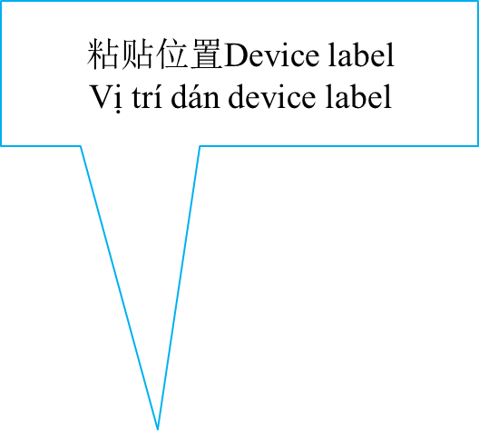
Thank you

